Slide 1

DSA5101 Machine Learning Project Bank Marketing Prediction
Haoyang Liu

Slide 2
Data Set and Problem Statement
Data set: bank-full.csv
Marketing campaigns data of a banking institution
45,211 data points
15 independent variables
7 numeric
8 categorical
Problem Statement
Build a classification model to predict if the client will subscribe a term deposit
Useful for future marketing plans

Slide 3
Dataset Pre-processing
Data Cleaning
Check null values and duplicate values
Deal with “unknown” data
Handle the outliers
Data Visualization
Feature encoding - OrdinalEncoder
Data normalization - MinMax
Feature engineering
Correlation matrix
Feature selection - Information Gain

Slide 4
Experimental Study and Analysis
Results of Models on the Test Dataset
Model Metric | Random Forest | SVM | KNN
MCC Score | 0.489 | 0.495 | 0.368
SVM and Random Forest models perform fairly close and both outperform KNN !

Slide 5
Why KNN not performed well as others?
Experimental Study and Analysis
Main reason : Unbalanced Dataset
According to the classification principle of KNN, if the dataset is unbalanced, when classifying a new sample, the majority of the k neighbors of that sample are in the absolutely dominant category, resulting in the possibility of model misclassification and performance degradation.

Slide 6
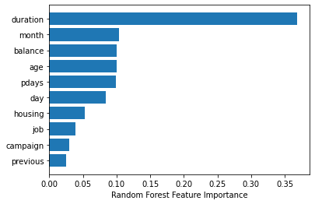
Feature Importance
Random Forest feature importance

Slide 7
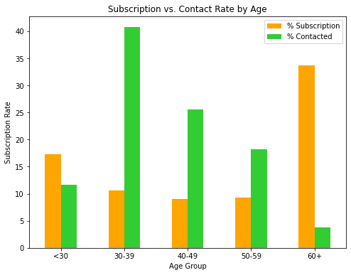
Data-Driven Insights
Subscription and contact rate by 'age'
Target: age < 30 or age > 60

Slide 8
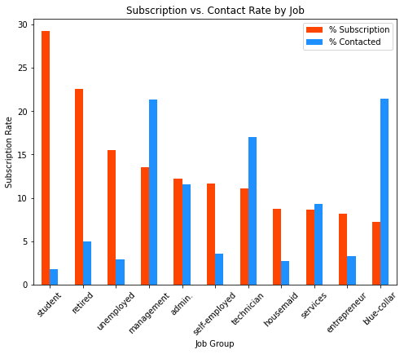
Data-Driven Insights
Subscription and contact rate by 'age'
Target:
students or retired

Slide 9
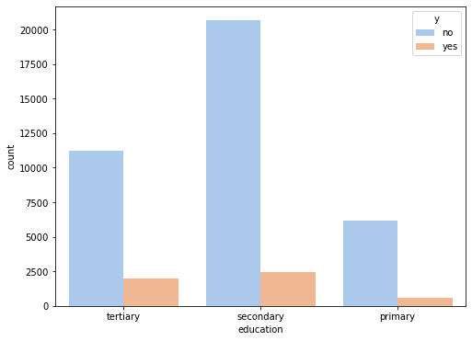
Data-Driven Insights
Subscription distribution by 'education'
Target:
Secondary education

Slide 10
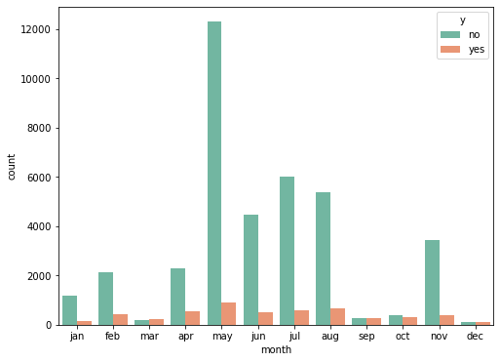
Data-Driven Insights
Subscription and contact rate by 'month'
Target:
Mar., Sept., Oct. and Dec.

Slide 11
Conclusion
SVM (RBF) & Random Forest
Target Client Profile
age < 30 or age > 60
students or retired
secondary education
Wise marketing effort allocation
Secure deposit & accurate campaigns delivery

Slide 12
Future Directions for Further Improvements
Balance the dataset by oversampling or undersampling.
Tunning the hyperparameter of random forest model
with a better way

Slide 13
Q & A

